Slide 1
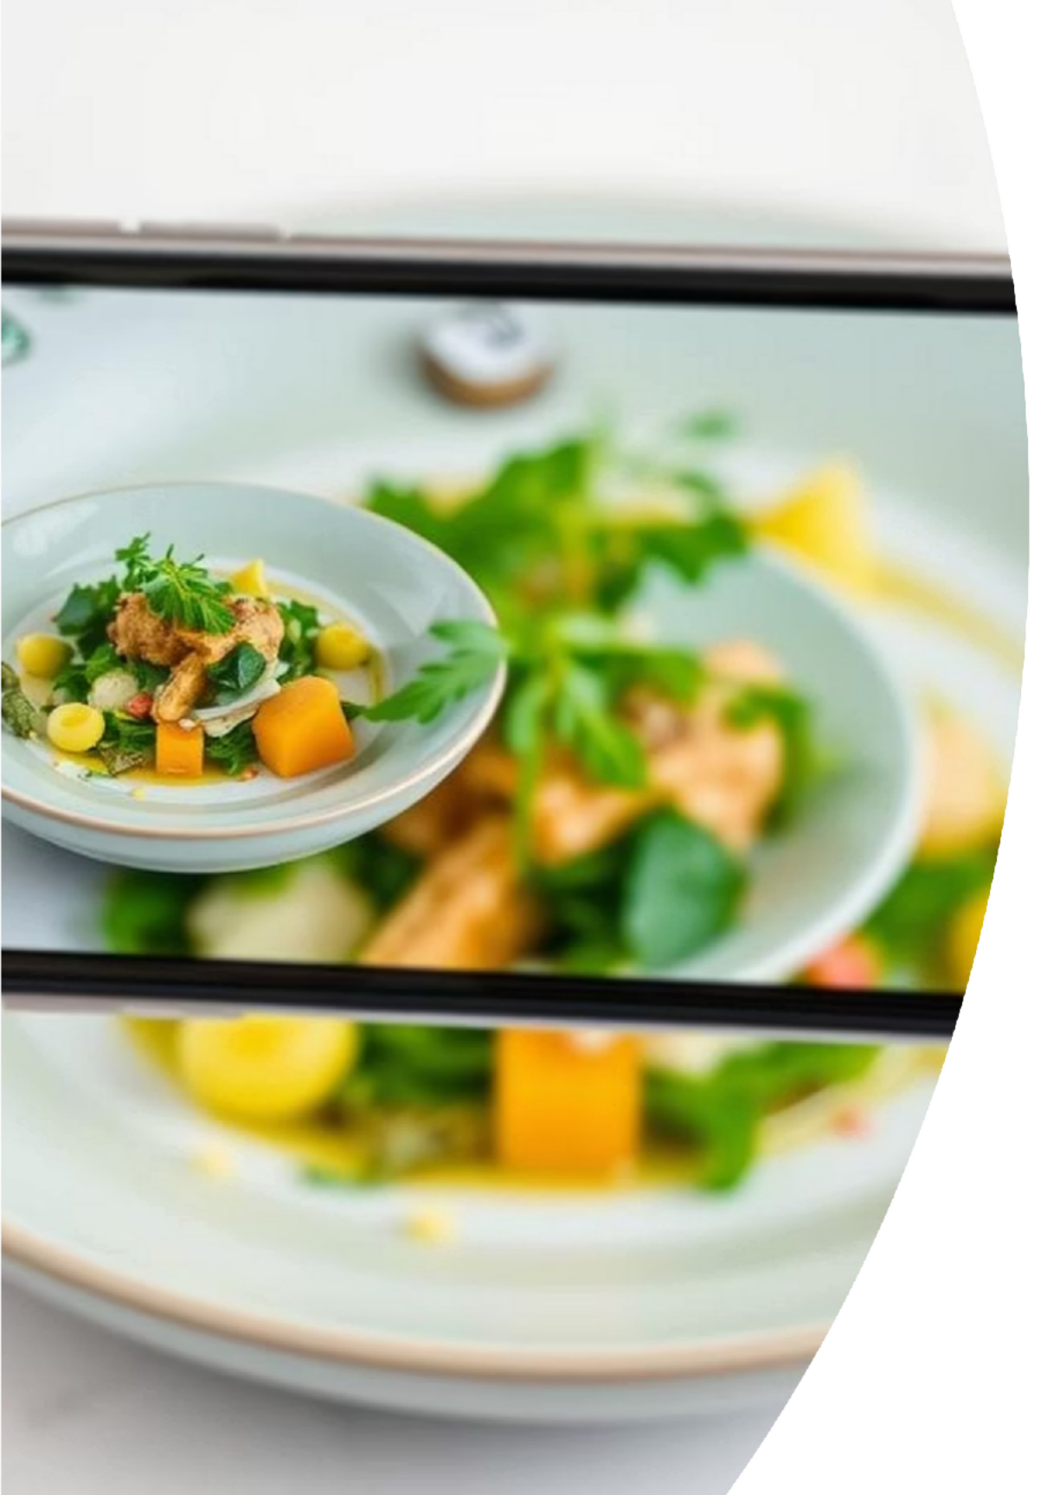

AI-Based Grocery List & Recipe Generator from Food Image
Presented by: Sumeet Sutar, Disha M, Kavana B A, G. P. Sujana

Slide 2
Automating Culinary Exploration
In a world of enticing food images, finding recipes can be time-consuming. Our AI-driven system identifies dishes from images, generating instant grocery lists and recipes. This solution simplifies meal planning, promotes smarter shopping, and enhances culinary discovery.
Problem
Manual recipe searching is inefficient.
Solution
AI-based dish identification and recipe generation.
Impact
Streamlined meal planning and grocery shopping.

Slide 3
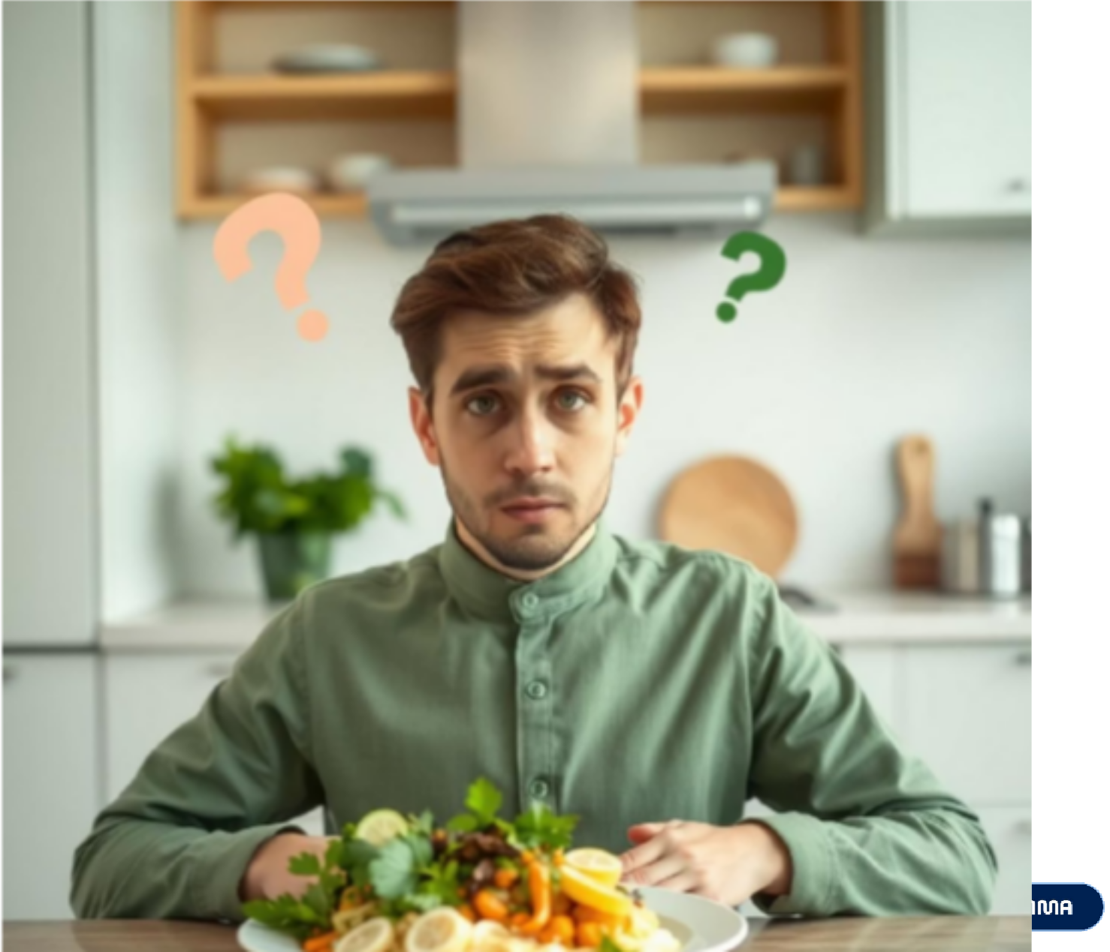
Addressing the Modern Lifestyle Gap
Modern lifestyles demand convenience. Users frequently encounter appealing food images but lack immediate access to essential culinary details. Our project bridges this gap by providing an automated solution for dish identification and recipe generation.
Challenges Faced by Users:
Unknown dish names
Undisclosed ingredients
Lack of cooking instructions

Slide 4
Key Project Objectives
Our system is designed with clear objectives to deliver a seamless and efficient user experience from image upload to recipe output.
1 2
Image Input
Accept food images from users via a user-friendly web interface.
Dish Recognition
Utilize a robust image recognition model to accurately identify the specific dish.
3
AI-Powered Generation
Leverage AI to generate a comprehensive grocery list and step-by-step recipe instructions.
4
Output Presentation
Display results cleanly with options to download or share the generated output in a professional format.

Slide 5
Technology Architecture
Frontend | HTML, CSS, JavaScript for a responsive web interface
Backend | Flask (Python) for server-side logic and API handling
AI Image Model | Gemini API key for advanced image recognition and analysis
Text Generator | Gemini API for intelligent recipe and grocery list creation
PDF Generation | ReportLab (Python) for professional PDF export of results
This stack ensures a robust, scalable, and user-friendly system, leveraging leading AI and web technologies.

Slide 6
Implementation Workflow
Our system processes food images through a precise, multi-stage workflow, from initial upload to final output generation and display.
Image Upload
Users upload food images via the intuitive web interface.
Image Analysis
The image is encoded and processed using a pre-trained vision model for dish classification.
AI Prompting
The classified dish name is sent to a large language model, which returns a structured recipe and grocery list.
Display & Output
Dish name, grocery list, and recipe steps are clearly displayed on the user interface.
PDF Export
A professional PDF of the grocery list and recipe is generated for download or sharing.

Slide 7
Future Enhancements
We envision several key enhancements to expand the system's capabilities and user value, transforming it into a more comprehensive culinary assistant.
Voice Assistant
Multilingual
Voice-based recipe assistance for hands-free cooking.
Support for multiple languages to cater to a global audience.
User Profiles
Grocery API
Personalized user profiles and upload history tracking.
Integration with grocery delivery APIs for direct shopping.
Nutritional Info
Community Features
Estimation of nutritional information for health-conscious users.
Options for users to share and rate recipes within the platform.

Slide 8
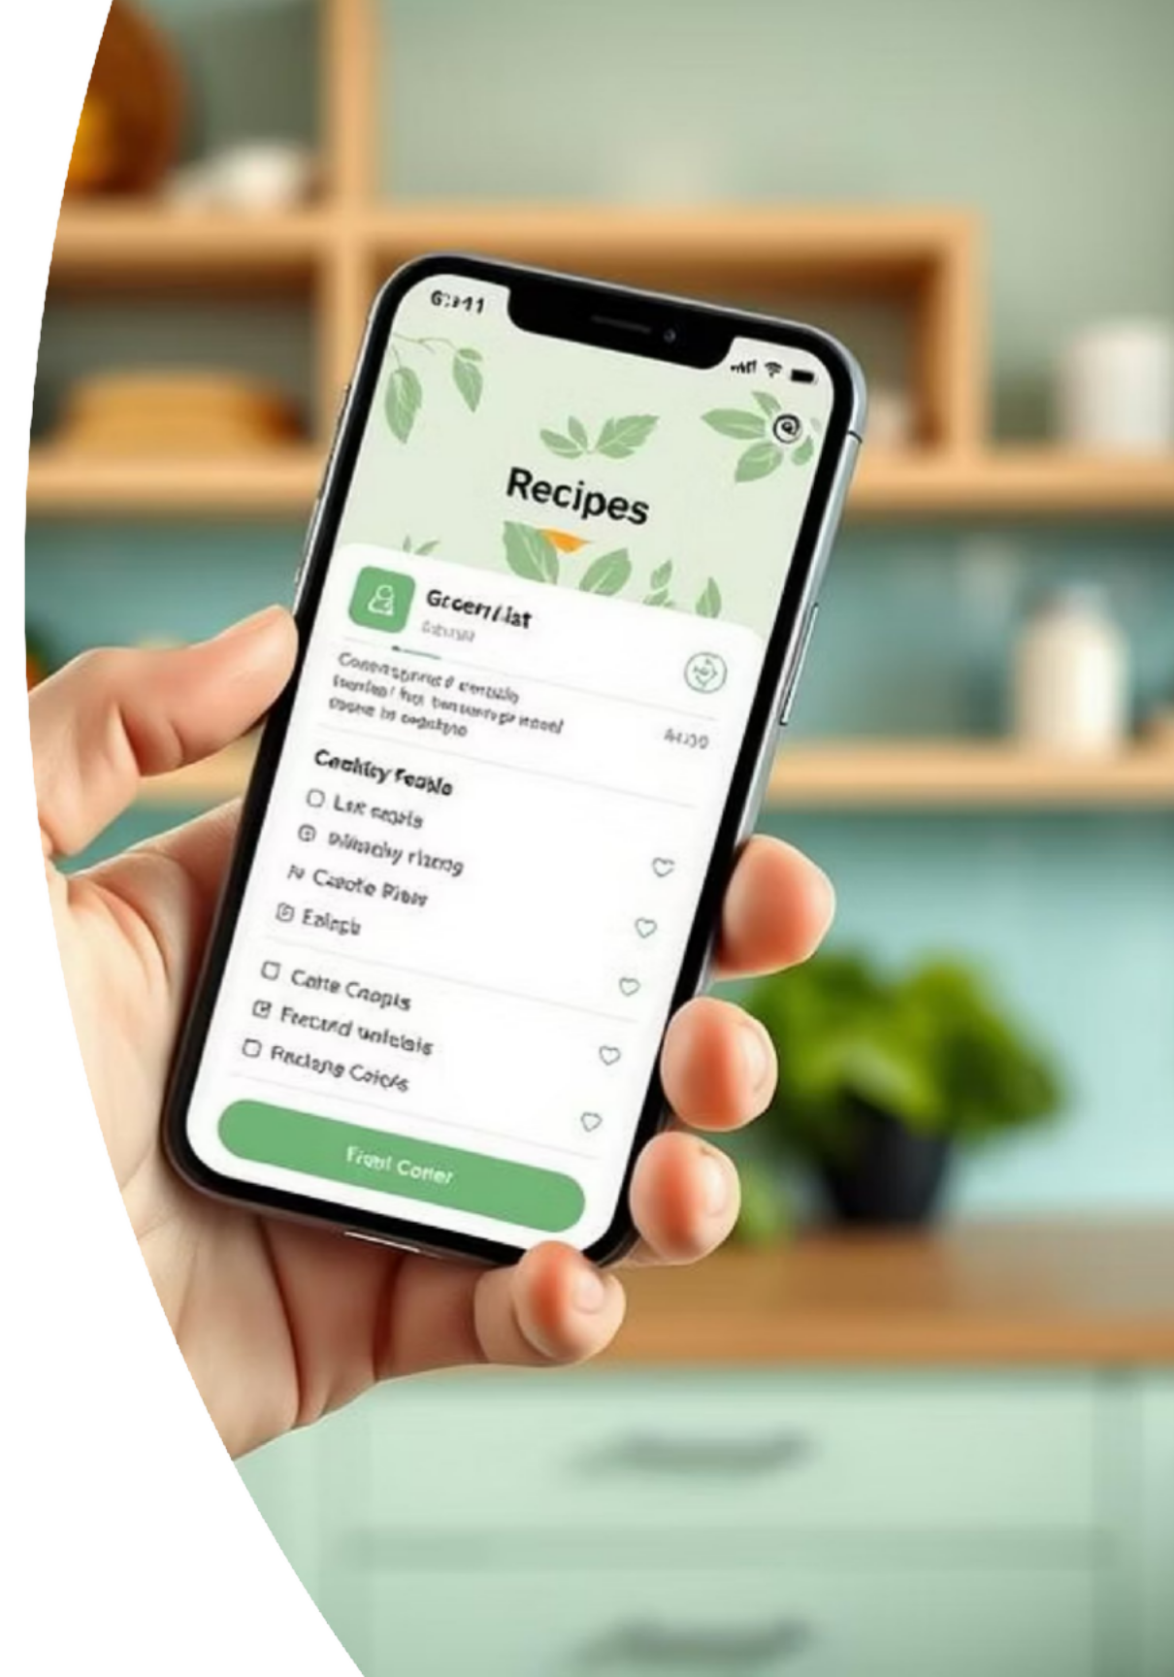
Conclusion & Impact
This project effectively demonstrates the power of AI in automating daily culinary decisions. By simply uploading a food image, users can now instantly generate complete grocery lists and cooking instructions, revolutionizing meal preparation.
This scalable solution holds significant real-world utility in smart kitchens, innovative cooking applications, and advanced health planning systems.

